Slide 1
APOLOGETICS
IN ONE LESSON
almost
Ai1L.net
Lesson 2
Gardening and Harvesting

Slide 2
IDEA IN BRIEF
What?
Time on “pre-evangelism” is time well spent; a call-to-action every time is not required
Why?
So that we don’t overload our audience or ourselves
How?
By showing that the conversion process has more than one step

Slide 3
What are some topics that it doesn’t make sense to focus on?
1

Slide 4
What are some topics that it likely does make sense to focus on?
2

Slide 5
What does it mean that Paul planted, and Apollos watered?
3

Slide 6
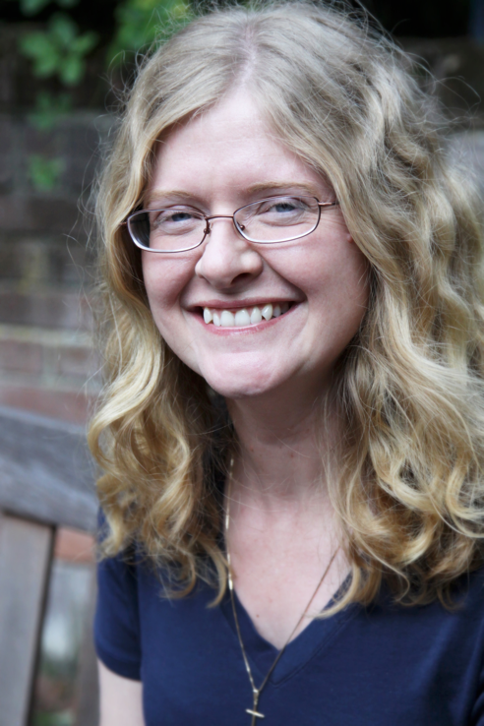
“﻿The bright sunlight that at first reduces everything to a painful dazzle of white, and seems even to take away your power of sight… It takes time for one’s eyes to adjust.”
HOLLY ORDWAY Not God's Type

Slide 7
Describe the distinction between the sower and the reaper in John 4:35-39
4

Slide 8
Describe the Gospel to someone who doesn’t know what it is
5

Slide 9
Key Takeaways
1
Time on “pre-evangelism” is time well spent; give yourself credit even if all you do is ask some questions
2
Getting to the “call-to-action” in every conversation is not required (and in some cases, not a good idea)

